Slide 1
UNDERSTANDING KING COUNTY’S HOUSING MARKET

Slide 2
GROUP 5 MEMBERS
Lisa Mwikali Japhet Cheboiywo Purity Gitonga Cynthia Dalmas Brian Ochieng Bethuel Maruru

Slide 3
01
INTRODUCTION

Slide 4
Throughout our presentation we hope to find important insights as we explore the huge world of real estate data that will aid in the comprehension of the dynamics of the housing market in King County.
We will walk you through each step of the process of developing and assessing our linear regression model and go over the main factors that affect home values, talk about the issues with linear regression, and use analysis and visualizations to show off our model's ability to predict outcomes. By the end of the presentation, we hope to provide insights that can be used in similar datasets , in addition to demystifying the complexity of real estate prediction.

Slide 5
02
PROJECT GOALS

Slide 6
PROJECT GOALS
DATA EXPLORATION
MODEL DEVELOPMENT
Examine the features and structure of datasets.
Examine the relationships between the variables.
Build a linear regression model
Prepare the data for training the model.
FEATURE SELECTION
MODEL EVALUATION
Determine the main predictors of home values.
Utilize statistical methods and domain expertise.
Evaluate the model's performance ( MSE).
Validate model generalization.

Slide 7
PROJECT GOALS
INSIGHTS GENERATION
Regression coefficient interpretation.
Get insights that stakeholders can use.

Slide 8
03
DESCRIBING THE DATA

Slide 9
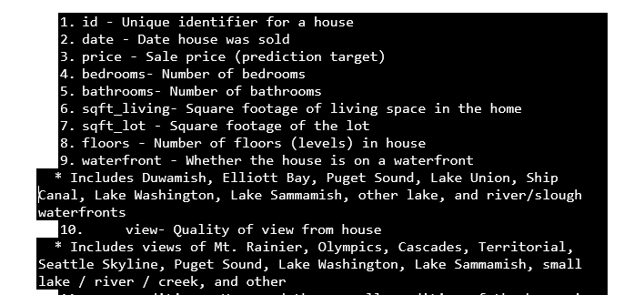
The King County dataset had 21 columns and 21,597 rows before anything was done on it.

Slide 10
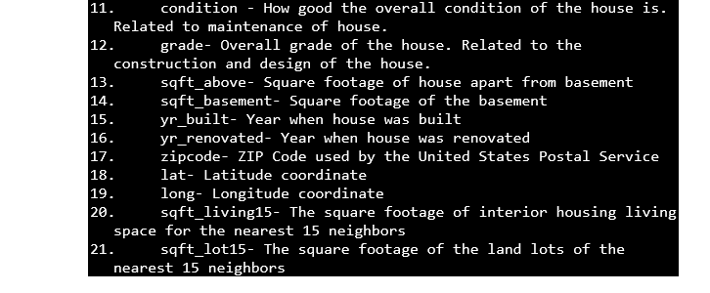

Slide 11
04
DESCRIBING THE METHODS

Slide 12
DATA PRE PROCESSING
Data Loading and Preview:
Using the data.head() and data.info() functions, we loaded the dataset and imported the required libraries to see a preview of its structure.
Managing The Missing Values
We determined which columns in the dataset had missing data and we were able to establish that the waterfront, view and yr_renovated columns had missing values. We were able to establish that there was a sizable percentage of missing data on yr_renovated and waterfront , so we removed those and imputated values for the view column

Slide 13
Feature engineering
To be able to carry out our analysis we extracted relevant data from already-existing columns, such as the numeric portion of the "grade" column.

Slide 14
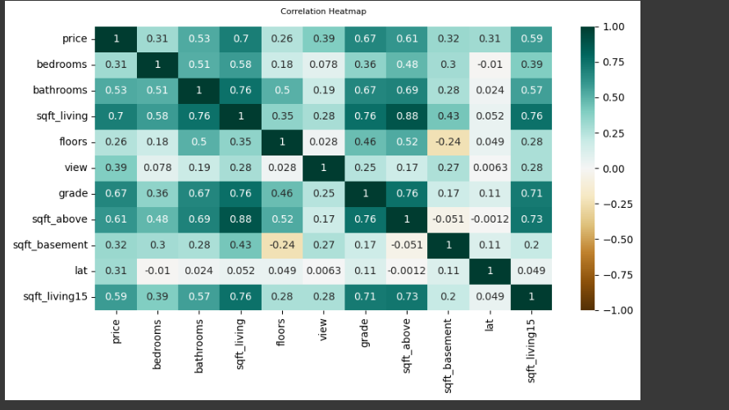
EXPLORATORY DATA ANALYSIS
In order to obtain insight into the data, we investigated correlations between variables and used heatmaps, pair plots, and scatter plots to depict associations.
Correlation Heat Map showing relationships between key features and house prices

Slide 15
Correlation Heat Map Findings
"sqft_living," "bathrooms," and "grade" show a strong positive correlation with the "price" of the house because their correlation is close to 1. Meaning that as the living area, number of bathrooms, or grade of the house increases, the price will increase as well.
"zipcode" has a slight negative correlation nearing -1 with price if certain areas tend to have lower prices
"yr_built" and "price" have a low correlation coefficient close to 0, indicating that the year a house was built might not have a strong linear impact on its price.
There is multicollinearity between "sqft_above" and "sqft_living" because they are highly correlated
Based on the heatmap, we decided to select features that have a strong correlation with the "price“ for model building. It helped us in identifying important predictors and potentially dropping less relevant or highly correlated predictors to improve model efficiency

Slide 16
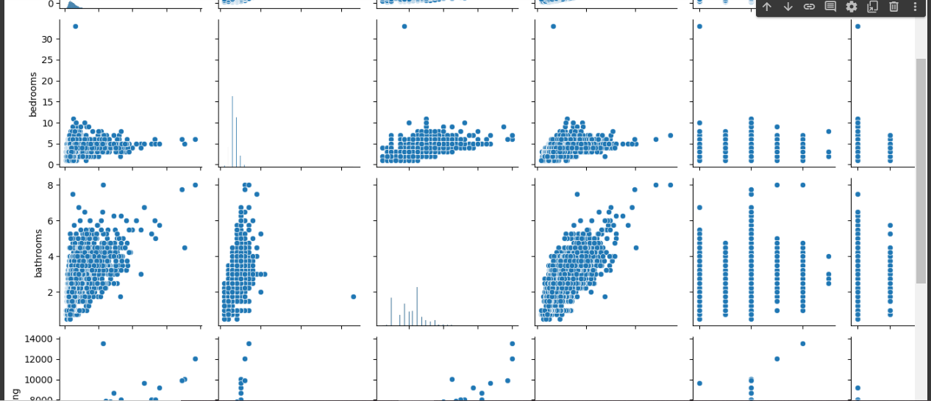
Pair Plot showing relationship among the variables

Slide 17
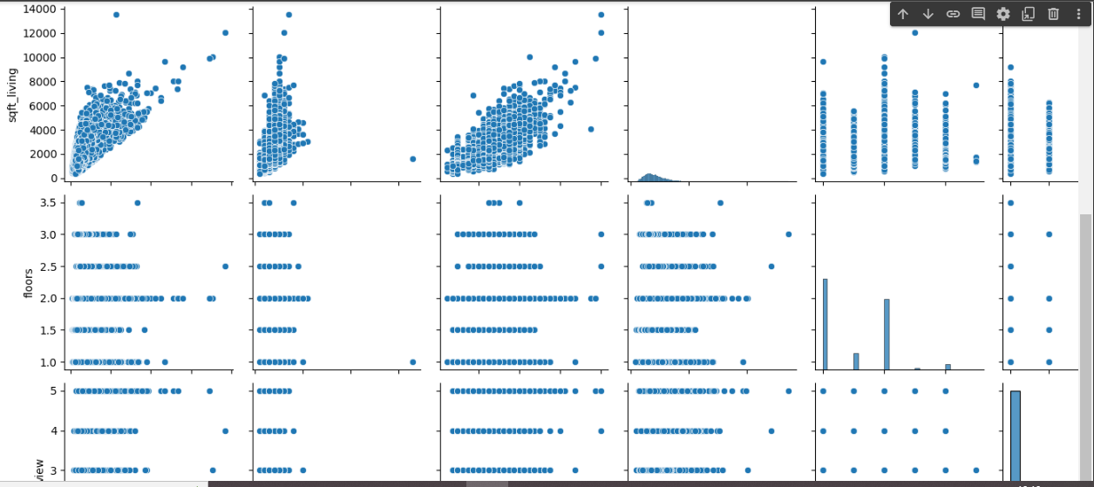
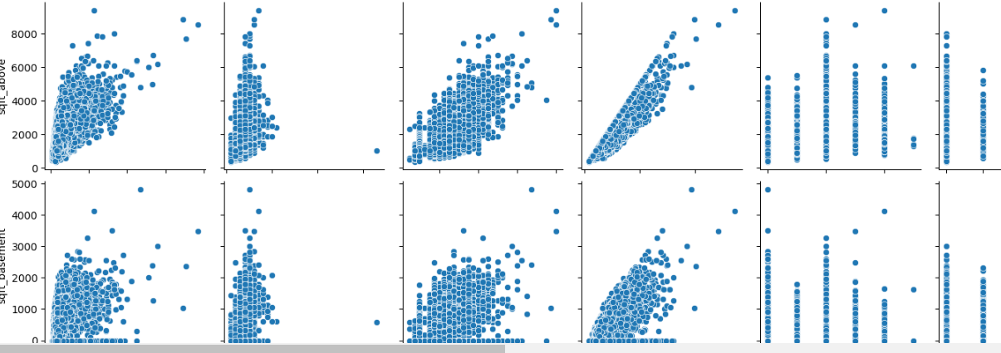
Pair Plot showing relationship among the variables

Slide 18
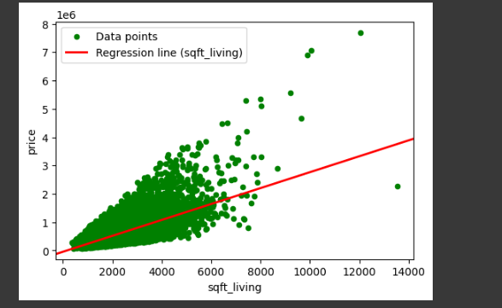
BUILDING REGRESSION MODELS
BASELINE MODEL
Using the "sqft_living" variable, we first created a baseline linear regression model. We then used metrics like R-squared and mean squared error (MSE) to assess the model's performance.
visualising the scatter plot and the line of best fit for the baseline model

Slide 19
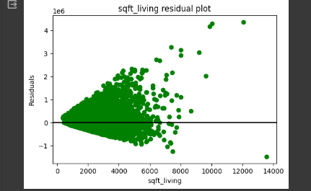
BUILDING REGRESSION MODELS
Residual Plot for the baseline model

Slide 20
Interpretation of the findings for the baseline model
The intercept value (-43,988.89) represents the estimated price of a house when the independent variable (sqft_living) is zero. In our case this interpretation is not practical since a house cannot have a living area of zero, so, it signifies the baseline value of the model.
The coefficient (280.86) indicates that for every one unit increase in (sqft_living), the price of the house is estimated to increase by 280.86. This coefficient represents the change in the (price) per unit over change (sqft_living).
The R-squared value of 0.493 suggests that approximately 49.3% of the variance in house prices can be explained by the linear relationship with square footage of living space
The p-value for the F-statistic is 0.00, meaning that the model is statistically significant.

Slide 21
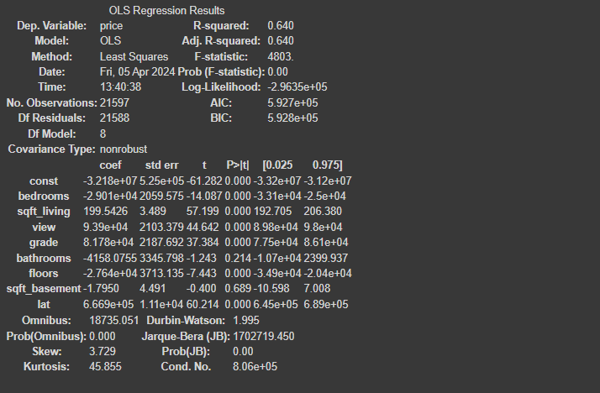
MULTIPLE LINEAR REGRESSION MODELS
We used all of the features to create a multiple linear regression model, which we then optimized by removing variables of little or no relevance.
Regression Results using all the features

Slide 22
Interpretation of the findings for the multiple linear regression model using all the features
The intercept value (-3,218,420) represents the estimated price of a house when all the independent variables in the model are zero. In our case having all variables at zero might not make sense so we took the intercept as the baseline value of the model.
Based on the coefficients;
A one-unit increase in the number of bedrooms is associated with a decrease in price by 2,901.335, when all the other variables are kept constant.
For every additional square foot of living space, the price is estimated to increase by 199.5426, when all the other variables are kept constant.
A better view quality is associated with an increase in price by 93,899.58, when all the other variables are kept constant.
Higher grades correspond to higher prices, with an increase of 81,784.08 for each grade point, when all the other variables are kept constant.
Each additional floor is associated with a decrease in price by 27,637.31, assuming other variables remain constant.
Changes in latitude have a substantial impact on prices, with an increase of 666,856.7 per unit change in latitude, when all the other variables are kept constant.
The R-squared value of 0.64 indicates that approximately 64% of the variance in house prices is explained by the linear relationship with the multiple independent variables.

Slide 23
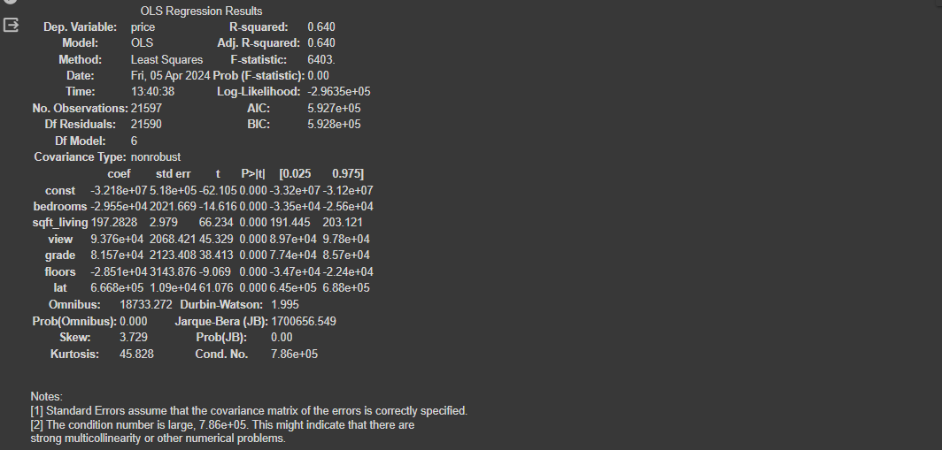
MULTIPLE LINEAR REGRESSION MODELS
Regression Results after dropping variables that have a P(t) greater than a standard alpha 0.05

Slide 24
Interpretation of the findings for the multiple linear regression model after dropping variables that have a P(t) greater than a standard alpha 0.05
The R-squared value of 0.640 indicates that approximately 64% of the variance in house prices can be explained by the independent variables included in the model.
Based on the coefficients;
For every square foot increase in living space, the price increases by 197.28
A better view quality corresponds to an increase in price by 93,760
Higher grades result in higher prices, with an increase of 81,570 for each unit increase in grade
Additional floors are associated with a decrease in price by 28,510
Changes in latitude have a significant impact on prices, with an increase of 666,800 per unit change in latitude

Slide 25
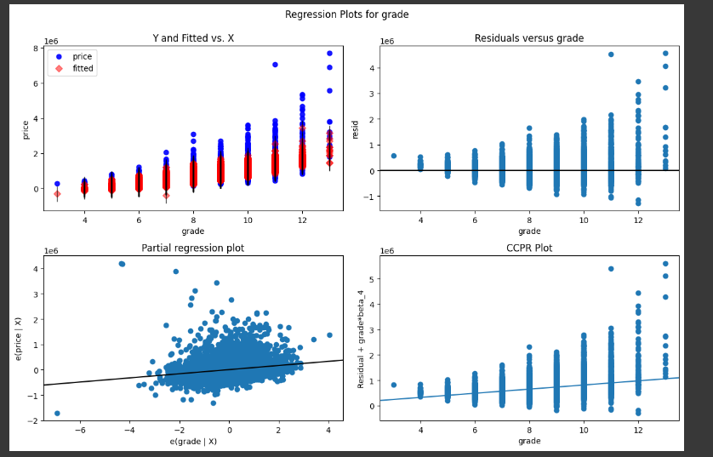
Plotting Regression Plot for Grade

Slide 26
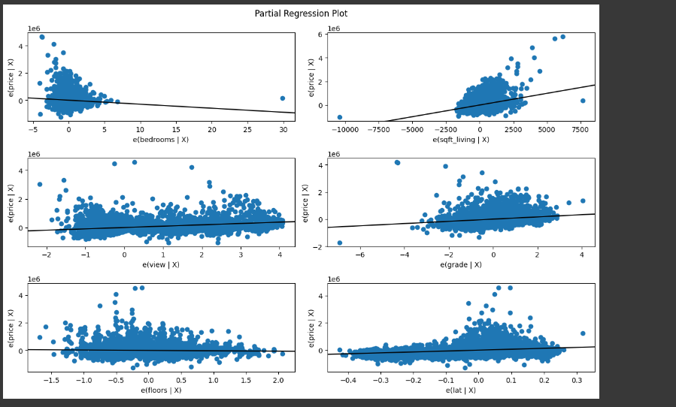
Plotting Partial Regression Plot for the Multiple Linear Regression

Slide 27
POLYNOMIAL REGRESSION
Using R-squared and MSE, we compared the performance of several degrees (2–5) of polynomial regression models in order to identify non-linear correlations between features and the target variable.
2 degrees
The MSE of approximately 200710.51 indicates the average squared difference between the predicted price and the actual price in the test data set.
The R-squared value of 0.715 suggests that about 71.5% of the variance in (price) is explained by the independent variables in the training data set.
The R-squared value of 0.708 indicates that the model explains about 70.8% of the variance in the test data set. This value is close to the training R-squared, suggesting that the model can be used to generalize well to unseen data.
3 degrees
The MSE of approximately 192833.78 is lower than the MSE for the degree 2 model, indicating potentially better predictive performance.
The R-squared value of 0.738 on the training data suggests that this degree 3 polynomial model explains about 73.8% of the variance.
The R-squared value of 0.731 on the test data indicates good generalization performance, as it is close to the training R-squared.

Slide 28
POLYNOMIAL REGRESSION
4 degrees
The MSE of approximately 192963.83 is similar to that of the degree 3 model.
The R-squared value of 0.749 on the training data indicates that this degree 4 polynomial model explains about 74.9% of the variance.
The R-squared value of 0.73 on the test data suggests that the model's generalization performance is comparable to the degree 3 model.
5 degrees
The MSE of approximately 206093.91 is higher than that of the degree 3 and degree 4 models, indicating potential overfitting or decreased generalization performance.
The R-squared value of 0.752 on the training data suggests that this degree 5 polynomial model explains about 75.2% of the variance.
The R-squared value of 0.692 on the test data indicates a drop in generalization performance compared to the lower-degree models, which could be a sign of overfitting.

Slide 29
05
Conclusion

Slide 30
In conclusion, based on our analysis, the Polynomial Regression Model with a degree of 3 (PR_Model_3) provided the best performance with an R-squared (testing) score of 0.731. Therefore, we concluded that polynomial regression is the best solution for predicting house prices in the King County dataset.

